Slide 1

SOQL Wave Tool
Using SOQL Wave tool to create Wave datasets
Mohan Panneerselvam
Senior Consultant - Appirio
mohan@appirio.com
@pmohankumar
Dustin Weaver
Senior Consultant - Appirio
dweaver@appirio.com
@appiriodustin

Slide 2
Safe Harbor
Safe harbor statement under the Private Securities Litigation Reform Act of 1995:
This presentation may contain forward-looking statements that involve risks, uncertainties, and assumptions. If any such uncertainties materialize or if any of the assumptions proves incorrect, the results of salesforce.com, inc. could differ materially from the results expressed or implied by the forward-looking statements we make. All statements other than statements of historical fact could be deemed forward-looking, including any projections of product or service availability, subscriber growth, earnings, revenues, or other financial items and any statements regarding strategies or plans of management for future operations, statements of belief, any statements concerning new, planned, or upgraded services or technology developments and customer contracts or use of our services.
The risks and uncertainties referred to above include – but are not limited to – risks associated with developing and delivering new functionality for our service, new products and services, our new business model, our past operating losses, possible fluctuations in our operating results and rate of growth, interruptions or delays in our Web hosting, breach of our security measures, the outcome of any litigation, risks associated with completed and any possible mergers and acquisitions, the immature market in which we operate, our relatively limited operating history, our ability to expand, retain, and motivate our employees and manage our growth, new releases of our service and successful customer deployment, our limited history reselling non-salesforce.com products, and utilization and selling to larger enterprise customers. Further information on potential factors that could affect the financial results of salesforce.com, inc. is included in our annual report on Form 10-K for the most recent fiscal year and in our quarterly report on Form 10-Q for the most recent fiscal quarter. These documents and others containing important disclosures are available on the SEC Filings section of the Investor Information section of our Web site.
Any unreleased services or features referenced in this or other presentations, press releases or public statements are not currently available and may not be delivered on time or at all. Customers who purchase our services should make the purchase decisions based upon features that are currently available. Salesforce.com, inc. assumes no obligation and does not intend to update these forward-looking statements.

Slide 3

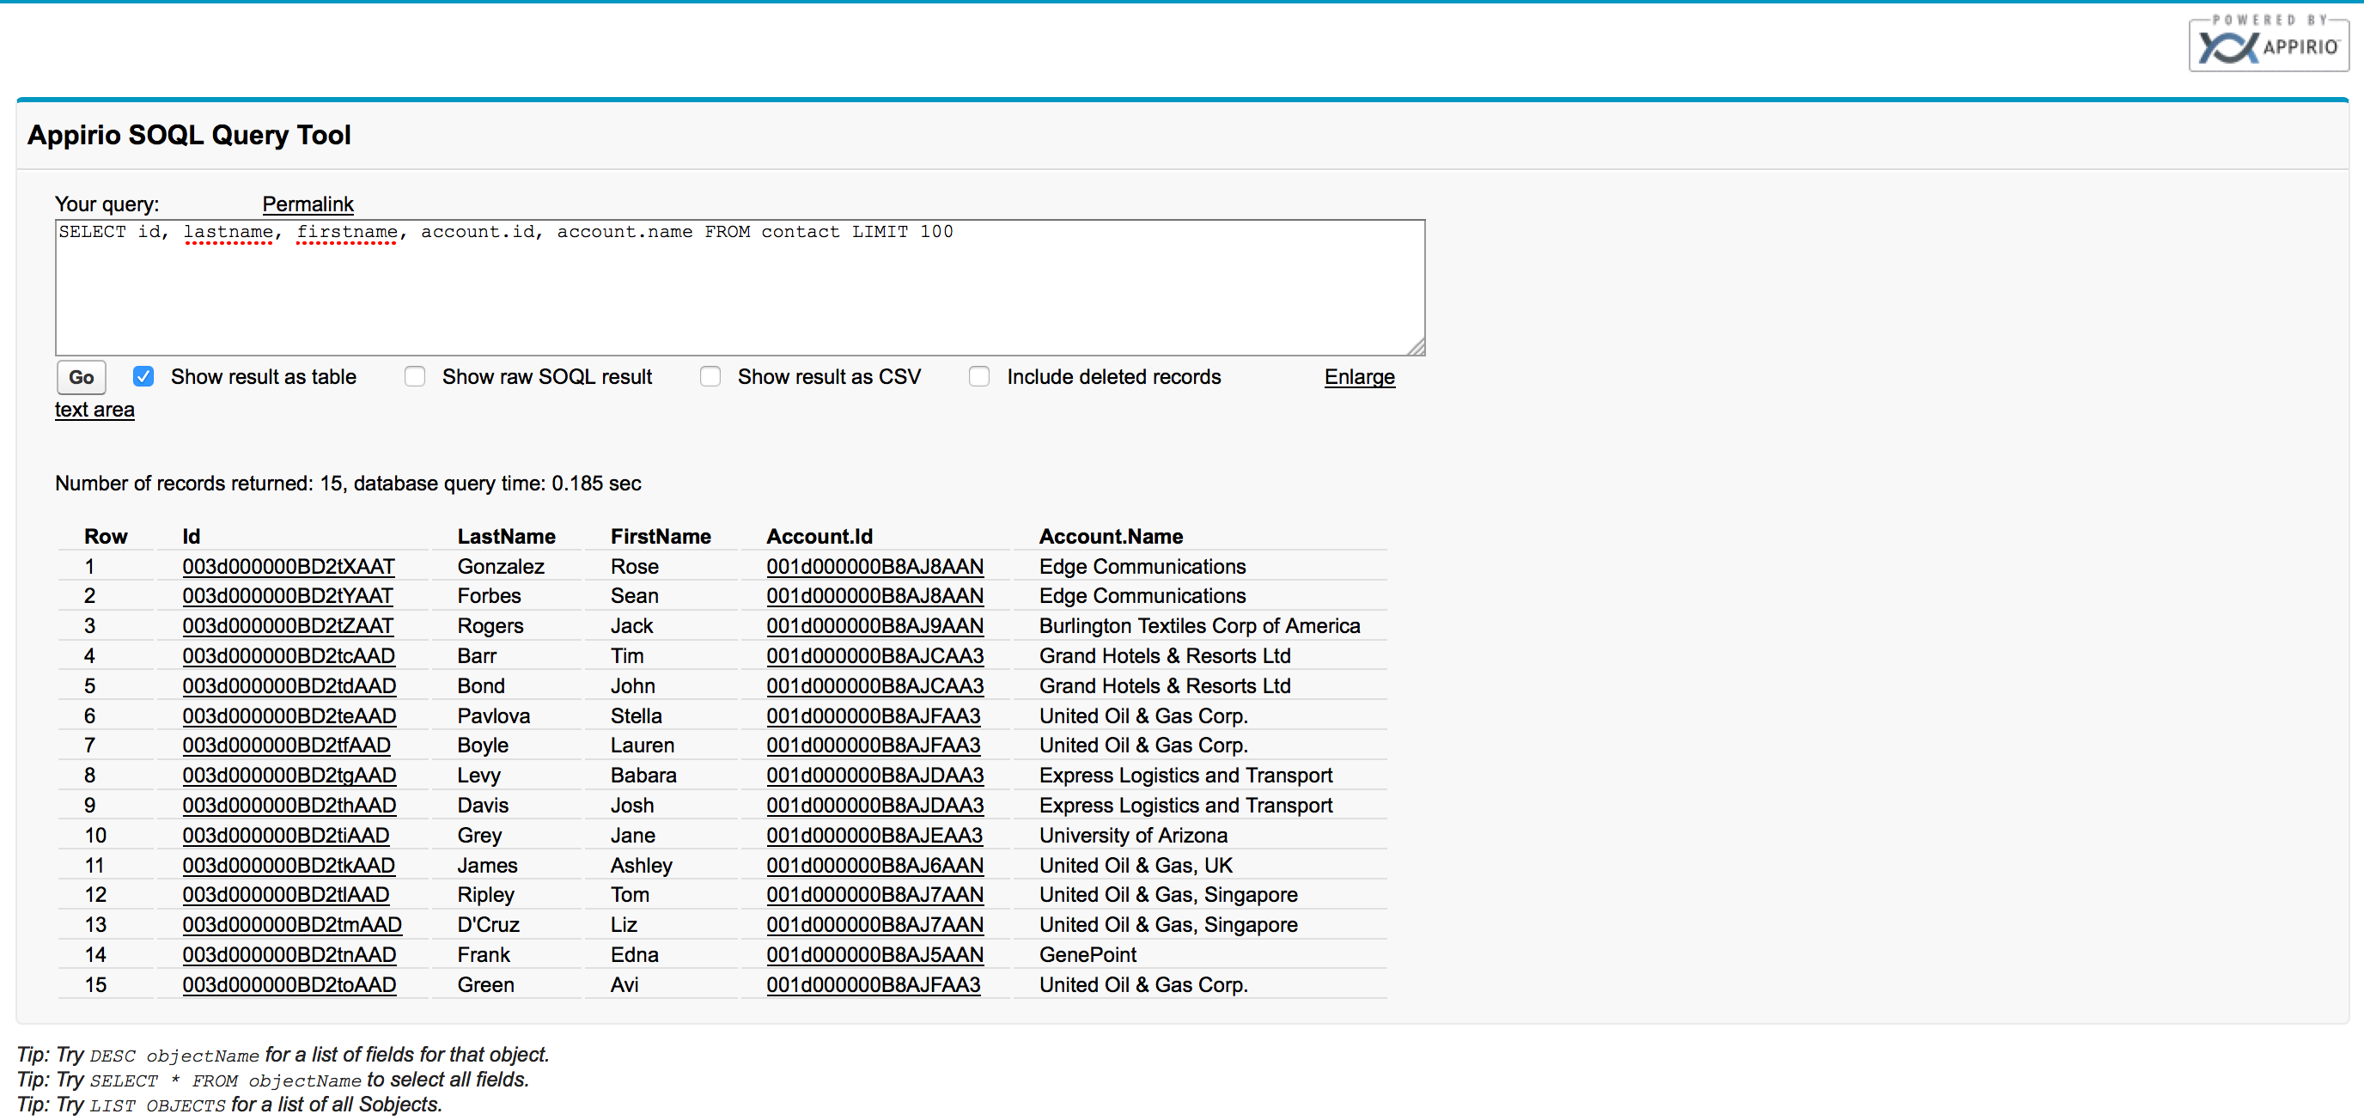
Appirio’s SOQL tool
VisualForce/Apex used to run SOQL
Uses AJAX API instead of an Apex controller
Results appear in an HTML table.
SELECT * syntax.
Supports the DESC command.
Supports LIST OBJECTS to see a list of all sobjects.
Output in CSV format.
Relational-type style - joined fields show actual data

Slide 4
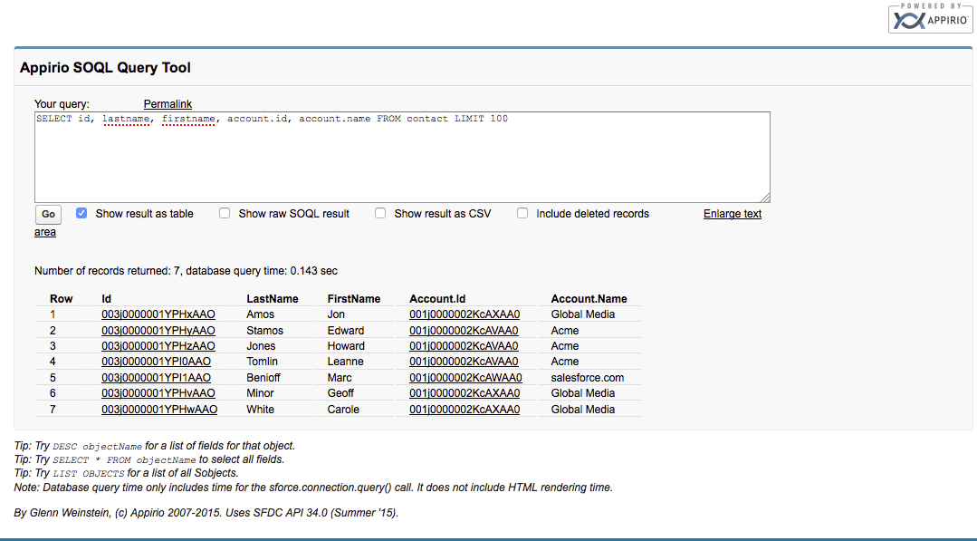

Appirio’s SOQL Tool (cont.)
Getting data from Salesforce.com
Author SOQL statement
Select Options
Press ‘Go’
Notes:
SOQL Tool Demo

Slide 5
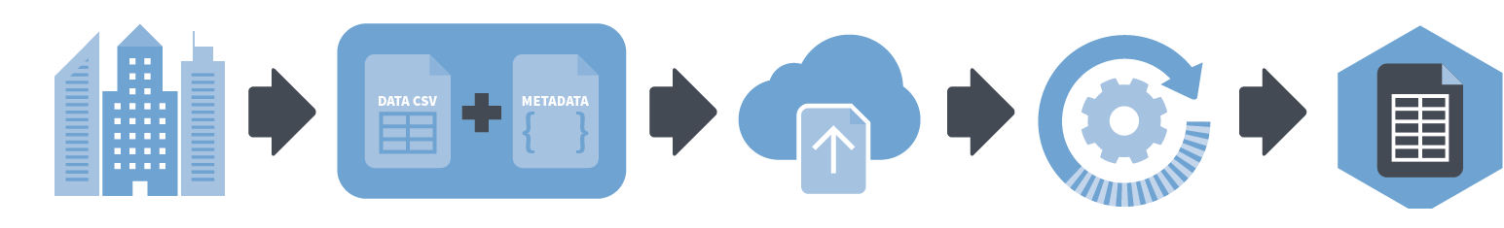
External Data API
Getting data into Wave
Prepare External Data
Create CSV of external data
Create JSON Metadata file
CSV Schema
Security
Upload files via Salesforce.com API
Base64 encoded
CSV file split into 10MB chunks
System job created and creates the dataset
Dataset created

Slide 6


External Data API (cont.)
Objects used for Wave
InsightsExternalData- Definition of the Dataset
Key Fields:
EdgemartAlias
MetadataJson
Operation
Action
InsightsExternalDataPart - Data for the Dataset
Key Fields:
PartNumber (10MB Chunk)
DataFile

Slide 7

Metadata JSON
The “schema” of a dataset
"fields" : [ {
"name" : "ID",
"fullyQualifiedName" : "Test.ID",
"label" : "ID",
"description" : "ID",
"type" : "Text",
"precision" : 0,
"scale" : 0,
"defaultValue" : "",
"isSystemField" : false,
"isUniqueId" : false,
"isMultiValue" : false,
"multiValueSeperator" : null,
"acl" : null,
"fiscalMonthOffset" : 0
} ]

Slide 8




SOQL Wave
Using SOQL to bring Salesforce data into Wave
Built on top of Appirio’s SOQL tool.
UI based tool to create/update dataset.
User fiendly UI to update key elements in metadata JSON.
Use BatchApex & supports up to 50 million records.
Splits & batches data up to 10MB per datapart.
Visual tracking of upload progress.

Slide 9

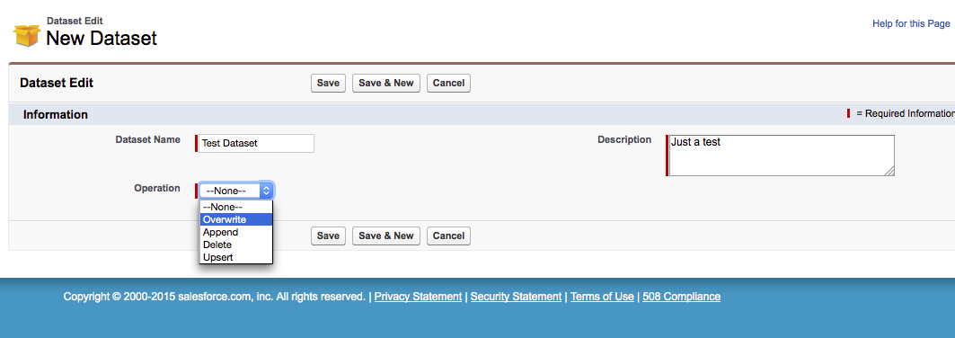
SOQL Wave – New Dataset
Creating the dataset container
Give dataset name
Select an operation
Overwrite – Overwrite dataset every import
Append – Append to data every import
Delete – Remove dataset
Upsert – Update/Insert data based on Id
Notes:
Demo

Slide 10
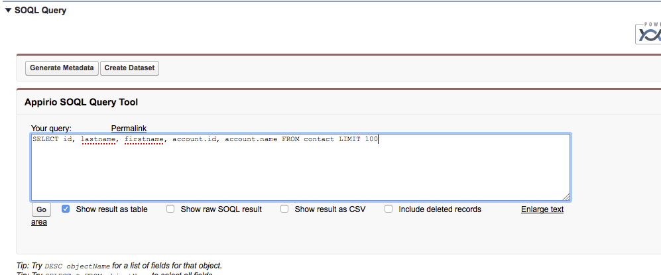
SOQL Wave – Author SOQL
Create your SOQL query
Notes:
Demo

Slide 11

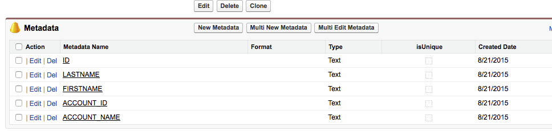
SOQL Wave – Metadata List
Editing the schema
Verify Type
Text – Dimension
Date – Date dimension
Numeric – Fact
Change Format
Numeric – Example: $#,##0.00 ($1,230.00)
Date – Example: MM/dd/yyyy (09/14/2015)

Slide 12
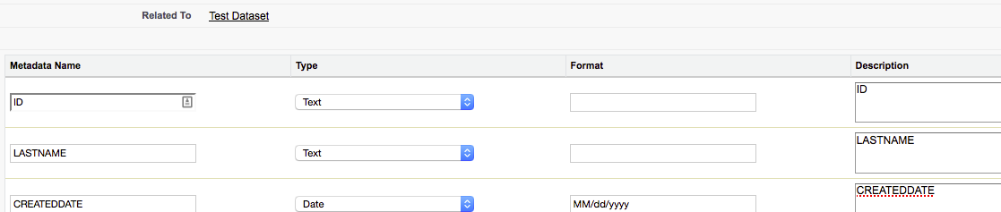
SOQL Wave – Metadata Multi-edit
Editing more than one metadata entity at once
Quick way to edit the entire schema at once
Standard Salesforce.com multi-edit screen

Slide 13

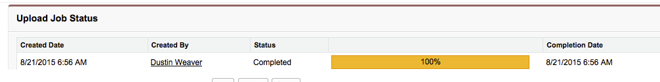
Execution & Monitoring
Checking the progress in SOQL Wave
Upload status
Getting data from objects through External API
Live progress bar
Visible on dataset screen

Slide 14

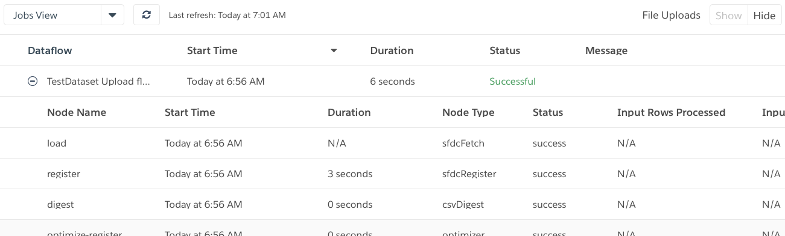
Execution & Monitoring (Cont.)
Checking the progress in Wave
Data Monitor
Ensure on ‘Jobs View’
Find dataset job
Status will give info

Slide 15

SOQL Wave – How and Why We Built It
Assets and Quick Delivery
How? - Asset Library
Over 2300 reusable assets
Four assets used for SOQL Wave
Tool built within a few days
Shared in library for future use
Why?- Simple UI to delivery data
Getting data into Wave (Earlier releases) required dataflow or JAR file
Both approaches required detailed knowledge of data
Created complexity
SOQL Wave made process easy
No prior knowledge of data
Dataset created in a few clicks

Slide 16

Documentation and Package Link
Where to get more information
GitHub: https://github.com/Appirio/SOQL-Wave/wiki
Installation Guide
Documentation specific to SOQL Wave
Examples
Unmanaged package link
Wave Metadata Documentation: https://resources.docs.salesforce.com/sfdc/pdf/bi_dev_guide_ext_data_format.pdf
Metadata documentation
Date/Numeric format options

Slide 17


Thank you!

